Slide 1
Female Firefighter Thermoregulation & Health

Slide 2
Background
A set core temperature is normally maintained by the body
Thermoregulation is challenged by environmental extremes
Sweating is limited when wearing protective clothing
Research indicates females are less tolerant to hot environments than males
A higher core temperature is needed to stimulate sweating in females
Heat tolerance may also be altered by hormone release in females
Notes:
A set core temperature of 37(+- 0.5ºC) is usually maintained by the body (Casa et al., 2015)
Thermoregulation is the process of maintaining a set core temperature and is challenged by environmental extremes such as heat (Cheuvront et al., 2010)
Firefighters wearing protective clothing have a limited ability to sweat due to the creation of microenvironments from layered clothing (Eglin, 2007)
Females are less tolerant to hot environments than males and 39% of female firefighters reported having a heat related illness (Watkins et al., 2019)

Slide 3
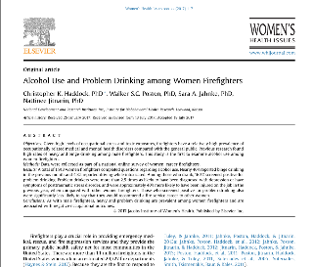
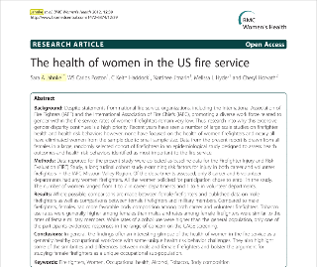
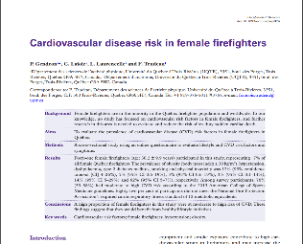
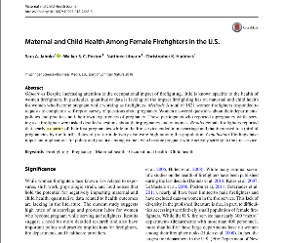
Background
Jahnke et al. 2012 (USA)
Obesity: 16.7% of females vs 33.5% of males
High blood pressure: 16.7% vs 53.9%
Average to High Strength: 94.1% vs 84.6%
Haddock et al. 2017 (USA)
Alcoholic Binge Drinking: 39.5% female vs 50% male
Problem drinkers 2.5 times more likely to have PTSD
Gendron et al. 2018 (Canada)
76% at moderate to high CVD risk
82% not meeting fitness requirements
Jahnke et al. 2018 (USA)
10-15% don’t restrict duties when pregnant
73.9% running fire calls
23 - 33% miscarry
12-17% of births pre-term (<37 weeks)
Majority of health & exposure research has been conducted on male firefighters
Notes:
Could this mean menopausal women are at no greater risk of heat illness because their heat dissipation response starts sooner??
No statistical difference at this point – neither group is specifically worse in terms of heat tolerance
Perceptual response may be greater in menopausal perhaps? So feel hotter but not necessarily core temp hotter?

Slide 4
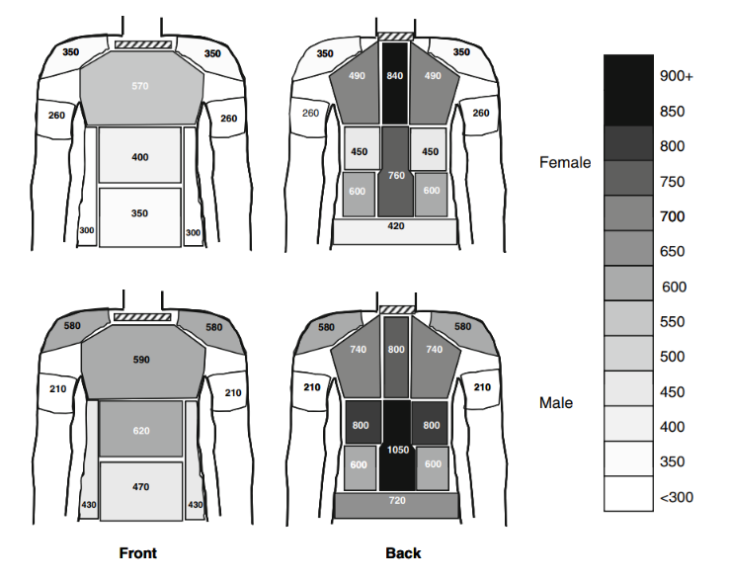
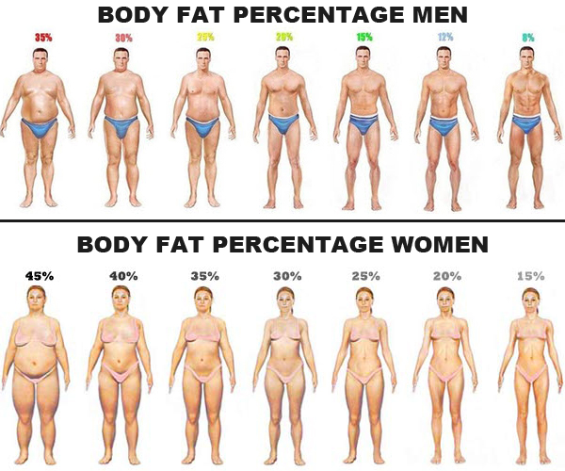
Are sex differences important?
1.4 L.hr⁻¹ vs 0.6 L.hr⁻¹
Notes:
For same body weight – women typically have greater body fat percentage – fat has lower specific heat capacity, meaning less heat is needed to increase the temperature of fat than to increase the temperature of lean body mass. Thicker subcutaneous layer mean a reduced blood flow to enable evaporation of heat
Less sweat per gland in females

Slide 5
Health
NA 2-7 times more likely to experience health issues caused by the occupation
UK & I 10-20% experience musculoskeletal injuries or depression/PTSD
Notes:
10% of UK&I accounts for nearly 400 people.
Small proportion of concern around fertility issues – difficulties conceiving or carrying to full term
How does this compare to previous studies???
44% back pain firefighters
Due to heavy lifting, weight of PPE & BA and wearing restrictive boots?
2-16% have coughing/breathing issues. Firefighters 1.23 times more likely to develop adult onset asthma and also reported by instructors in recent survey.
17% of FFF mental health issues. Previous research 10-32% (Perrin et al 2014) female no more likely to experience PTSD than males. Still greater than 2-14% of general population
A number of responses referred to the work of the firefighters charity with the great help of physiotherapy.

Slide 6
Health
Is the menopause something you are worried about in relation to your working environment and/or tasks?
Change in strength & fitness
Lack of Knowledge
17% are peri/menopausal
39% it impacts working life
36% worried about the menopause
Fatigue
Dizzy Spells
Changes in temperature regulation
Mood Swings
Concern for mental health
Strength Loss
Embarrassment in male environment
Hot flushes
If you are currently experiencing the menopause, does this have any impact on your working life?
Notes:
10% of UK&I accounts for nearly 400 people.
Small proportion of concern around fertility issues – difficulties conceiving or carrying to full term
24% FFF menstrual cycle effects them at work – thermal tolerance, hygiene issues (facilities), fatigue

Slide 7
Health
Only 16% were confident they would be able to meet the demands of their job at 60 yrs of age
“ I don't know if I will be able to achieve 60 but I will give it a good try! I do feel let down by changes to the pension and retirement age and don't feel that females have been taken into account especially when I would imagine every female hitting menopause before this age! “
Meeting fitness standards
Loss of Strength
Mental toughness
“I haven't received any information or guidance on the effect of being an older lady & the menopause whilst being an operational firefighter”
Impact of the menopause
Injuries/pain

Slide 8
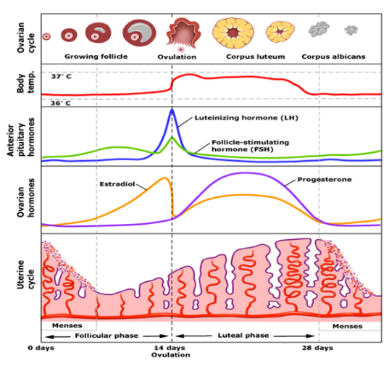
Menstrual cycle effects on thermoregulation
> Phases and hormones
The cycle lasts approximately 28 days and is made up of different phases with varying hormone levels
Oestrogen peaks before ovulation
Progesterone levels are low in the follicular phase
Oestrogen reduces body temperature
Progesterone increases vasoconstriction
Notes:
Follicular phase occurs from day 1 to day 14, followed by ovulation and luteal phase occurs from ovulation through to the end of the cycle
Oestrogen, which is predominantly released from ovarian cells, increases to a peak before ovulation and remains elevated during the luteal phase (Marsh and Jenkins, 2002)
Throughout the luteal and follicular phases progesterone levels are low (Marsh and Jenkins, 2002)
Oestrogen reduces body temperature and alters skin blood flow as well as sweating (Charkoudian, 2003)
Progesterone leads to increased core temperature (Marsh and Jenkins, 2002)

Slide 9
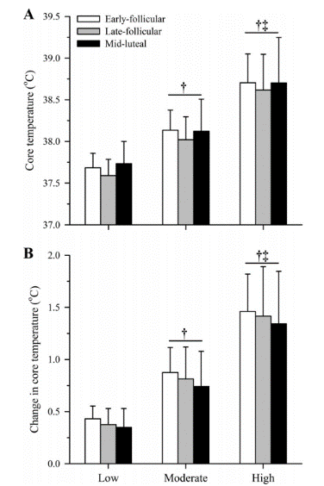
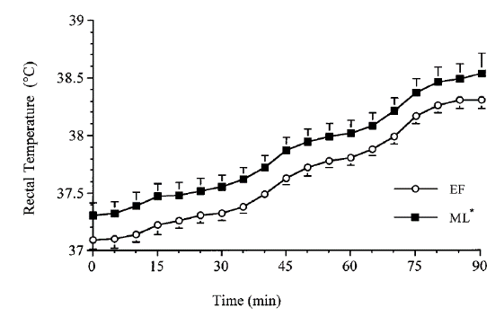
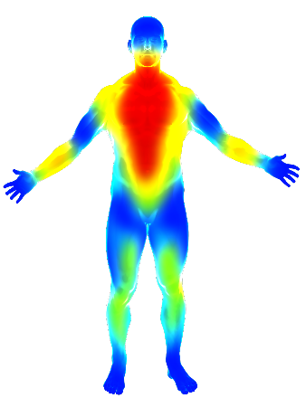
Menstrual cycle effects on thermoregulation
> Phases and hormones
Notes:
Tenaglia: 0.2 degree difference in core temp, whilst statistically different is small!
9 participants but very long duration exercise and not actually getting that hot until towards the end of the exposure.
Notley et al 2019 – yes differences in core temperature at the beginning, but no statistical difference in core temperature or change in core temperature. Differences quite small and human variance quite large?
Use behavioural thermoregulation – go slower if possible or choose to end earlier
Also research on use of hormonal contraception – some research says core temperature higher to start with but no consequence with compensable exercise, no difference in phases as hormones controlled throughout.

Slide 10
Menstrual cycle effects on thermoregulation
> Thermoregulation changes
Changing hormone levels affect thermoregulation throughout the cycle
Exercising in the heat delays the onset of sweating
There is a higher sweat rate in the follicular phase of the cycle
During the luteal phase it is possible to have a higher subjective feeling of exhaustion
Notes:
Sweating threshold temperature is greater during the luteal phase, delaying the onset of sweating until a higher core temperature is reached
Sweat rate is lower in the luteal phase than the follicular phase (Lee et al., 2014)
Altered sweat threshold and rate may be a result of lower concentrations of progesterone acting on warm-sensitive neurons (Kolka and Stephenson, 1989)
Sims and Heather (2018) state that the higher core temperature in the luteal phase may persist into exercise performance and lead to increased subjective feeling of exertion and reduced performance

Slide 11
Menstrual cycle effects on thermoregulation
> Fitness helps
During the luteal phase compared to the follicular phase, females fatigue quicker.
No differences in trained individuals
No difference in core temperature in trained individuals during the cycle
Evidence is conflicting as to whether thermoregulatory difference in menstrual cycle phases have an impact on exercising in the heat.
Notes:
Janse de Jong et a., (2012) state that it has been found that during exercise in the heat ladies fatigue quicker in the luteal than the follicular phase
Notely et al. (2018) found no differences between phases when exercising in exercise duration or core temperature
Kuwhara et al (2005) showed no difference in core temperature between phases of the menstrual cycle

Slide 12
Contraceptives and thermoregulation
> Types
Contraceptives prevent ovulation from occurring
Oral contraceptives lower core temperature
Long term use can lead to higher core temperature when exercising
However it was also found that there was no difference in skin temperature between users and non-users
Notes:
Oral contraceptives include oestrogen and progesterone
Users of oral contraceptives have been found to have a 0.2ºC lower resting core temperature whilst taking the pill (Tenaglia et al., 1999)
During the luteal phase it is suggested that oral contraceptive users may have greater heat tolerance capacity than non-users (Cheung, 2000)
Long term use of oral contraceptives can lead to higher core and skin temperatures following ~22mins exercise in the heat (Minahan et al., 2017)
Lei et al. (2017) and Tenaglia et al. (1999) found no difference in sweat rates or skin temperatures between those in the mid-luteal phase and those on oral contraceptives

Slide 13
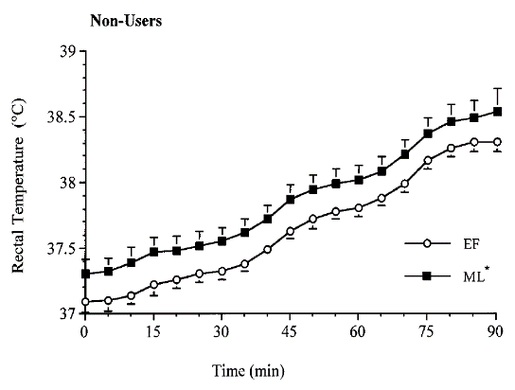
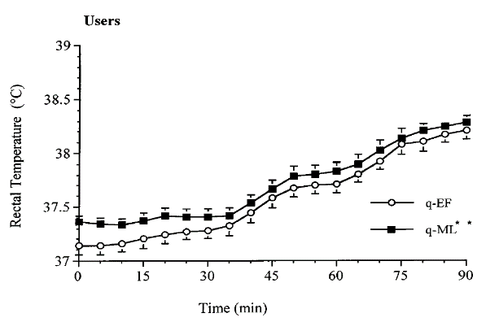
Contraceptives and thermoregulation
> Types
No difference was found in core temperature following exercise between users and non-users of oral contraceptives
Notes:
Difference in the rectal temperature between users and non-users of oral contraceptives in the early follicular and mid luteal phases of the cycle (Tenaglia et al., 1999)

Slide 14
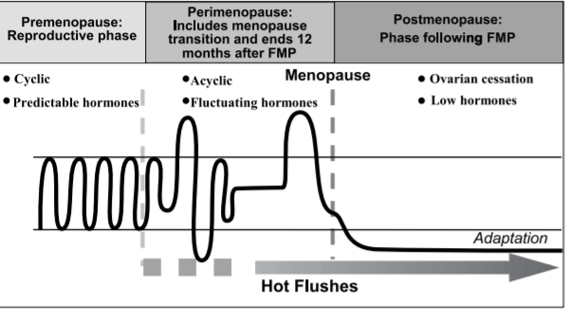
Menopause effects on thermoregulation
> What is the menopause?
Menopause occurs around the age of 51
It is when the ovaries stop producing reproductive cells
Notes:
Menopause occurs when the ovaries stop producing reproductive cells
Menopause has been reported to occur around the age of 51
Perimenopause occurs when ovarian function starts to decline (Bachmann, 2005)

Slide 15
Menopause effects on thermoregulation
> What does the menopause affect?
Perimenopause leads to variation in oestrogen levels
Approximately 80% of women experience hot flushes and night sweats through menopause
Varying oestrogen levels can effect females through sleep disturbance, somatically, and psychologically
Notes:
With perimenopause there are abrupt increases and decreases in oestrogen and rises in follicle stimulating hormone (Bachmann, 2005)
Instability of oestrogen can effect females somatically through fatigue, aches and pains, psychologically through mood disturbance and through sleep disturbances (Shaver and Paulsen, 1993)
Deecher and Dorries, (2007) state that 80% of women going through menopause will experience night sweats and hot flushes
hot flushes are associated with increases in skin temperature (Sturdee et al., 1978)
core temperature is seen to fluctuate during menopause, but is lower in post-menopausal women compared to premenopausal

Slide 16
Menopause effects on thermoregulation
> Thermo-neutral zone
Increases in core temperature result in heat dissipation due to acting outside the thermoneutral zone
In symptomatic women temperature limit narrows lowering the sweating threshold resulting in hot flushes until the core temperature returns to the thermoneutral zone
Notes:
Small core body temperature elevations acting within a reduced thermoneutral zone trigger hot flushes in symptomatic postmenopausal women (Freedman, 2005)
Heat dissipation response from increased core temperature is triggered due to acting outside the thermoneutral zone (Freedman and Blacker, 2002)
Symptomatic women’s temperature limits narrow to 0.0ºC from 0.4ºC due to lowered sweating threshold and increased shivering threshold (Freedman et al 1995) and therefore if core temperature reaches the threshold hot flushes occur until core temperature returns to the thermoneutral zone (Freedman 2014)

Slide 17
Menopause effects on thermoregulation
> Core temperature
Neither group is specifically worse in terms of heat tolerance
38.38 ± 0.3⁰C vs 38.72 ± 0.54 ⁰C
Notes:
Could this mean menopausal women are at no greater risk of heat illness because their heat dissipation response starts sooner??
No statistical difference at this point – neither group is specifically worse in terms of heat tolerance
Perceptual response may be greater in menopausal perhaps? So feel hotter but not necessarily core temp hotter?

Slide 18
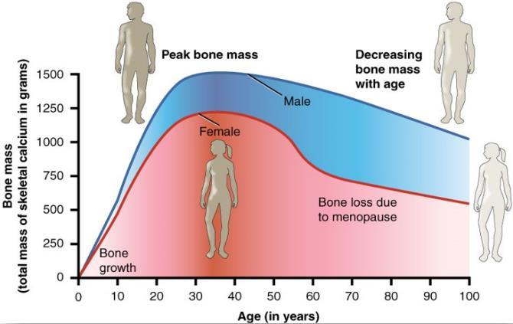
Bone, muscle and fitness with ageing
> Bone mineral density
There is a correlation between aging and decreasing bone mass
Declining bone mass leads to increased risk of fractures
Decreasing oestrogen levels leads to greater bone mass loss in women
Weight bearing and resistance exercise is beneficial for treatment and prevention of osteoporosis
Notes:
Higher core temperature at certain phases of cycle
Does it impact heat tolerance??
Should we be paying particular attention to pre/post cooling in those times of the month?
Bone mass – increased risk of breaks/fractures
Similar process with strength loss - 0.6% per year of muscle mass lost with menopause
Suggestions that resistance training can minimise this though! – regular fitness activity and weight bearing exercise can minimise these decrements and reduce risk of fractures
Hormone therapy could improve strength as link between estradiol and muscle contraction quality

Slide 19
Bone, muscle and fitness with ageing
> Cardiorespiratory fitness
There is some evidence that higher cardiorespiratory fitness levels reduce the risk of bone loss post-menopause
Regular exercise can aid to reduce the rate of bone loss
As age increases, maximal oxygen uptake declines
There are changes in cardiopulmonary function associated with menopause
Post menopause there is a lowered cardiorespiratory fitness level
Notes:
Some evidence that higher cardiorespiratory fitness levels will reduce risk of bone loss reducing the risk of osteopenia and osteoporosis in post-menopausal women (DeFina et al., 2016 )
Regular resistance based exercises can aid to reduce the risk of osteopenia, osteoporosis and fractures through reducing the rate of bone loss (Haskell et al., 2007)
VO_{2max} declines with increasing age (Betik and Hepple, 2008
Menopause associated changes in cardiopulmonary function are cause by low oestrogen and result in prevention of adequate oxygen flow required for rising demand in exercise (Abdulnour, 2016)
Cardiorespiratory fitness lowers post menopause due to body composition changing and worsened arterial vasodilation from age and menopause (da Rocha Arago, 2015)

Slide 20
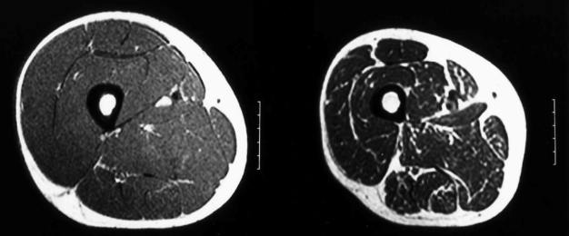
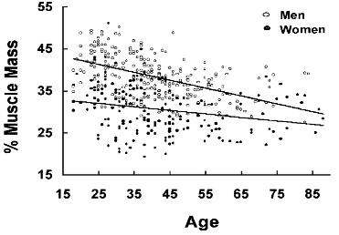
Bone, muscle and fitness with ageing
> Muscle mass & strength
Menopause can contribute to declining muscle mass
After the age of 50 there is a pronounced decline in muscle strength
Contradicting research exists as to whether this decline is linked to lowered oestrogen levels
Notes:
Menopause can contribute to declining muscle mass over time, known as sarcopenia, Rolland et al (2007) demonstrated a 0.6% loss per year after menopause
Research shows that over the age of 50 there is a pronounced decline in strength (Dogerty, 2001)
The drop in muscle mass and strength has been correlated with declining oestrogen levels by some research (Phillips et al., 1993) however this is contradicted by Humphries et al. (1992)
Cross sectional images of mid thighs from 24 year old (Left) and 65 year old (Right)

Slide 21
Bone, muscle and fitness with ageing
> Muscle mass & strength
Sufficient vitamin D intake is essential for bone health
Much of the decline in muscle strength can be attributed to reduced physical activity and hormonal changes
For women over 50, the recommended daily intake of calcium is 1200mg
Female firefighters should be encouraged to maintain fitness levels and strength based activities
Postmenopausal women can improve bone mineral density with appropriate nutrition
Notes:
Muscle and strength loss can be attributed to hormonal changes, reduced physical activity and reduced protein intake
Female firefighters should be encouraged to maintain fitness levels and strength based activities to maintain muscle mass
Recommendations from the national institutes of supplements (1029) state that women over 50 should consume 1200mg of elemental calcium a day primarily from food sources
Postmenopausal women's bone mineral density can be improved with appropriate vitamin D and calcium consumption (Roush, 2011)
Research suggests there is small and varied benefits of using vitamin D and calcium following menopause on bone mineral density

Slide 22
Fertility and Maternal Health
All UK Fire and Rescue services have individual policies for pregnancy
Certain aspects of firefighting increase the risk of miscarriage
Fertility is possibly altered
Notes:
Only 1 third of women restricted duties in 1st trimester, with some not restricting duties at all
Working night shifts and heavy lifting increase chance of miscarriage by 1,21 and 1.31 times (Nilsson et al., 2014)
Evidence in animals that heat stress and hyperthermia can have negative consequences on female fertility through altered hormone levels, decreased chance of fertilization and increased rate of miscarriage (Boni, 2019)
The impact of being a firefighter on maternal health and fertility is possibly due to heat exposure or other aspects of the role

Slide 23
Key Points
Little data is available as to how women react to severe heat stress
Women have an altered later sweat response and therefore reduced heat tolerance compared to men
Heat loss is aided by a higher sweat rate in the early follicular phase of the menstrual cycle
During peri-menopause hot flushes are caused by sudden small increases in core temperature
Post menopause there is a low resting core temperature, suggesting improved heat tolerance than pre-menopause
www.fbueducation.org

Slide 24
References
Abdulnour, J. (2016) The Effect of Menopausal Transition on Body Composition, Cardiometabolic Risk Factors, Physical Activity and Cardiorespiratory Fitness, unpublished thesis Université d'Ottawa/University of Ottawa.
Bachmann, G. A. (2005) "Menopausal vasomotor symptoms: a review of causes, effects and evidence-based treatment options", The Journal of reproductive medicine, 50 (3) pp. 155-165.
Betik, A. C. and Hepple, R. T. (2008) "Determinants of VO2 max decline with aging: an integrated perspective", Applied Physiology, Nutrition, and Metabolism, 33 (1) pp. 130-140.
Boni, R. (2019) "Heat stress, a serious threat to reproductive function in animals and humans: BONI", Molecular Reproduction and Development.
Casa, D. J., DeMartini, J. K., Bergeron, M. F., Csillan, D., Eichner, E. R., Lopez, R. M., Ferrara, M. S., Miller, K. C., O'Connor, F. and Sawka, M. N. (2015) "National Athletic Trainers' Association position statement: exertional heat illnesses", Journal of athletic training, 50 (9) pp. 986-1000.
Charkoudian, N. (2003) Skin blood flow in adult human thermoregulation: how it works, when it does not, and why, translated in Elsevier, 603-612.
Cheung, S. S., McLellan, T. M. and Tenaglia, S. (2000) "The thermophysiology of uncompensable heat stress", Sports Medicine, 29 (5) pp. 329-359.
Cheuvront, S. N., Kenefick, R. W., Montain, S. J. and Sawka, M. N. (2010) "Mechanisms of aerobic performance impairment with heat stress and dehydration", Journal of Applied Physiology, 109 (6) pp. 1989-1995.
da Rocha Aragão, F. (2015) Exercise, Body Composition, Cardiorespiratory Fitness and Menopausal Characteristics: Effects and Interactions, unpublished thesis Universidade de Tras-os-Montes e Alto Douro (Portugal).

Slide 25
References
Deecher, D. and Dorries, K. (2007) "Understanding the pathophysiology of vasomotor symptoms (hot flushes and night sweats) that occur in perimenopause, menopause, and postmenopause life stages", Archives of women's mental health, 10 (6) pp. 247-257.
DeFina, L. F., Leonard, D., Willis, B. L., Barlow, C. E., Finley, C. E., Jenkins, M. R., Pence, B. C., Zhang, Y., Chyu, M.-C., Lewiecki, E. M. and Shen, C.-L. (2016) "High Cardiorespiratory Fitness Is Associated with Reduced Risk of Low Bone Density in Postmenopausal Women", Journal of Women's Health, 25 (10) pp. 1073-1080.
Doherty, T. J. (2001) "The influence of aging and sex on skeletal muscle mass and strength", Current Opinion in Clinical Nutrition & Metabolic Care, 4 (6) pp. 503-508.
Eglin, C. M. (2007) "Physiological responses to fire-fighting: Thermal and metabolic considerations", Journal of the human-environment System, 10 (1) pp. 7-18.
Feodor Nilsson, S., Andersen, P. K., Strandberg‐Larsen, K. and Nybo Andersen, A. M. (2014) "Risk factors for miscarriage from a prevention perspective: a nationwide follow‐up study", BJOG: An International Journal of Obstetrics & Gynaecology, 121 (11) pp. 1375-1385.
Freedman, R., Norton, D., Woodward, S. and Cornélissen, G. (1995) "Core body temperature and circadian rhythm of hot flashes in menopausal women", The Journal of Clinical Endocrinology & Metabolism, 80 (8) pp. 2354-2358.
Freedman, R. R. (2014) "Menopausal hot flashes: mechanisms, endocrinology, treatment", The Journal of steroid biochemistry and molecular biology, 142 pp. 115-120.
Freedman, R. R. and Blacker, C. M. (2002) "Estrogen raises the sweating threshold in postmenopausal women with hot flashes", Fertility and sterility, 77 (3) pp. 487-490.

Slide 26
References
Haskell, W. L., Lee, I. M., Pate, R. R., Powell, K. E., Blair, S. N., Franklin, B. A., MacEra, C. A., Heath, G. W., Thompson, P. D. and Bauman, A. (2007) "Physical activity and public health: Updated recommendation for adults from the American College of Sports Medicine and the American Heart Association", Medicine and Science in Sports and Exercise, 39 (8) pp. 1423-1434.
Jahnke, S. A., Poston, W. S. C., Jitnarin, N. and Haddock, C. K. (2018) "Maternal and Child Health Among Female Firefighters in the U.S", Maternal and Child Health Journal, 22 (6) pp. 922-931.
Janse, X. D. J., Thompson, M. W., Chuter, V. H., Silk, L. N. and Thom, J. M. (2012) "Exercise performance over the menstrual cycle in temperate and hot, humid conditions", Medicine and science in sports and exercise, 44 (11) pp. 2190-2198.
Kolka, M. A. and Stephenson, L. A. (1989) "Control of sweating during the human menstrual cycle", European journal of applied physiology and occupational physiology, 58 (8) pp. 890-895.
Kuwahara, T., Inoue, Y., Abe, M., Sato, Y. and Kondo, N. (2005) "Effects of menstrual cycle and physical training on heat loss responses during dynamic exercise at moderate intensity in a temperate environment", American Journal of Physiology - Regulatory Integrative and Comparative Physiology, 288 (5) pp. R1347-R1353.
Lee, H., Petrofsky, J., Shah, N., Awali, A., Shah, K., Alotaibi, M. and Yim, J. (2014) "Higher sweating rate and skin blood flow during the luteal phase of the menstrual cycle", The Tohoku journal of experimental medicine, 234 (2) pp. 117-122.
Lei, T.-H., Stannard, S. R., Perry, B. G., Schlader, Z. J., Cotter, J. D. and Mündel, T. (2017) "Influence of menstrual phase and arid vs . humid heat stress on autonomic and behavioural thermoregulation during exercise in trained but unacclimated women: Thermoregulatory behaviour in trained women across the menstrual cycle", The Journal of Physiology, 595 (9) pp. 2823-2837.
Marsh, S. A. and Jenkins, D. G. (2002) "Physiological responses to the menstrual cycle", Sports Medicine, 32 (10) pp. 601-614.
Minahan, C., Melnikoff, M., Quinn, K. and Larsen, B. (2017) "Response of women using oral contraception to exercise in the heat", European journal of applied physiology, 117 (7) pp. 1383-1391.

Slide 27
References
National Institutes of Supplements, O. o. D. (2019) 'Calcium', [online], National Institutes of Health. Available: <https://ods-od-nih-gov.ezproxy.brighton.ac.uk/factsheets/calcium-HealthProfessional/> [Accessed 15th July 2019].
Notley, S. R., Dervis, S., Poirier, M. P. and Kenny, G. P. (2018) "Menstrual cycle phase does not modulate whole body heat loss during exercise in hot, dry conditions", Journal of Applied Physiology, 126 (2) pp. 286-293.
Notley, S. R., Dervis, S., Poirier, M. P. and Kenny, G. P. (2019) "Menstrual cycle phase does not modulate whole body heat loss during exercise in hot, dry conditions", Journal of applied physiology (Bethesda, Md. : 1985), 126 (2) pp. 286-293.
Rolland, Y. M., Perry Iii, H. M., Patrick, P., Banks, W. A. and Morley, J. E. (2007) "Loss of appendicular muscle mass and loss of muscle strength in young postmenopausal women", The Journals of Gerontology Series A: Biological Sciences and Medical Sciences, 62 (3) pp. 330-335.
Roush, K. (2011) "Prevention and Treatment of Osteoporosis in Postmenopausal Women: a review", The American Journal of Nursing, 111 (8) pp. 26-37.
Shaver, J. L. and Paulsen, V. M. (1993) "Sleep, psychological distress, and somatic symptoms in perimenopausal women", Family practice research journal.
Sims, S. T. and Heather, A. K. (2018) "Myths and Methodologies: Reducing scientific design ambiguity in studies comparing sexes and/or menstrual cycle phases", Experimental physiology, 103 (10) pp. 1309-1317.
Sturdee, D., Wilson, K., Pipili, E. and Crocker, A. D. (1978) "Physiological aspects of menopausal hot flush", Br Med J, 2 (6130) pp. 79-80.
Tenaglia, S. A., McLellan, T. M. and Klentrou, P. P. (1999) "Influence of menstrual cycle and oral contraceptives on tolerance to uncompensable heat stress", European journal of applied physiology and occupational physiology, 80 (2) pp. 76-83.
Watkins, E. R., Walker, A., Mol, E., Jahnke, S. and Richardson, A. J. (2019) "Women Firefighters’ Health and Well-Being: An International Survey", Women's Health Issues.

